Slide 1
Circular Flow of Income

Slide 2
Circular Flow of Income
The circular flow of income is an economic model that reflects how money or income flows through the different sectors of the economy. A simple economy assumes that there exist only two sectors, i.e., Households and Firms. Households are consumers of goods and services and the owners of the factors of production (land, labour, capital, and enterprise). However, the firm sector produces goods and services and sells them to households.
In the circular flow of income (two-sector economy), there is an exchange of goods and services between the two players, i.e., the firms and households, which leads to a certain flow of money in the economy. Households provide the firms with the factors of production namely, Land (Natural Resources), Labor, Capital, and Enterprise that generates goods and services, and consumers spend their income on the consumption of these goods and services. The firms then make factor payments to households in the form of rent, wages, interest, and profit. This flow of goods and services and factors payments between firms and households reflects the circular flow of money in an economy.

Slide 3
Types of Circular Flow
The two types of circular flow are Real Flow and Money Flow.

Slide 4
1. Real Flow
The flow of factor services from the households to the firms and the corresponding flow of goods from firms to the households in an economy is known as the Real Flow. Real flow is also known as Physical Flow. In this type of circular flow, there is no involvement of money and the goods and services are exchanged between the two sectors of the economy. This flow helps an economy in determining the magnitude of its growth process. For example, if more factor services are provided to the firms, then they will produce more volume of production, which will ultimately speed up the process of economic growth.

Slide 5
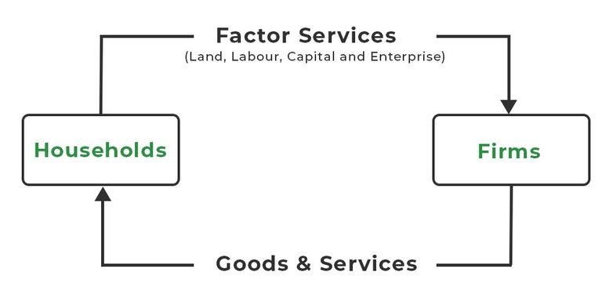
The above diagram shows that the households provide factor services to the firm, and as a reward for their productive services, the firms provide the household with goods and services.

Slide 6
2. Money Flow
The flow of factor payments from the firms to households for their factor services and the corresponding flow of consumption expenditure from households to the firms for the purchase of goods and services produced by the firms is known as Money Flow. Money flow is also known as Nominal Flow. This type of circular flow includes the exchange of money between the two sectors, i.e., households and firms.

Slide 7
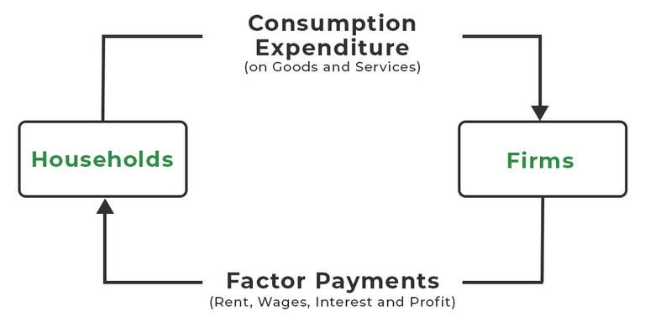
The above diagram shows that for the factor services provided by the households, firms make factor payments to them, and then households spend their income on the purchase of goods and services produced by these firms.

